Slide 1
TP RestFul API
https://github.com/ouared14/Mobile-Programming-2025/tree/main/TP-RestFullAPI

Slide 2

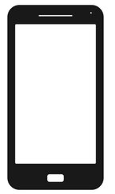
Obj → JSON
Obj → JSON
Query
Response
Web Server
Client
Obj ← JSON
Obj ← JSON

Slide 3

Install/Download XAMPP
Install phpMyAdmin

Slide 4
Create MySQL Database

Slide 5
Create Table
http://localhost/phpmyadmin/
Create table student
  first_name
  last_name
  date_of_birth
  email
  phone_number
CREATE TABLE student (
student_id INT AUTO_INCREMENT PRIMARY KEY,
first_name VARCHAR(50) NOT NULL,
last_name VARCHAR(50) NOT NULL,
date_of_birth DATE,
email VARCHAR(100),
phone_number VARCHAR(20),
registration_date TIMESTAMP DEFAULT CURRENT_TIMESTAMP
);

Slide 6
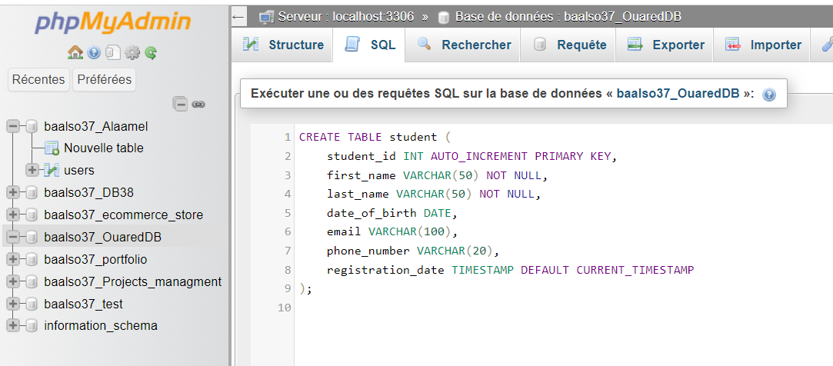

Slide 7
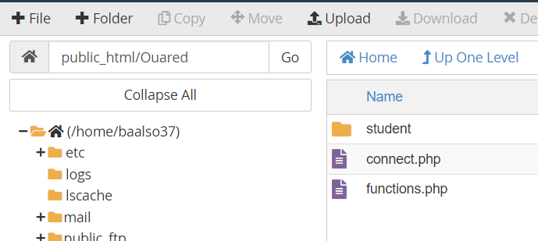
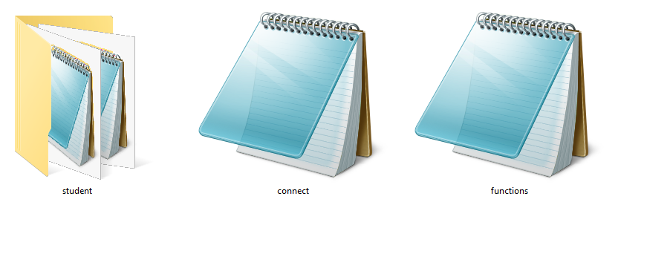
Backend
C:\xampp\htdocs

Slide 8
viewAllStudents
<?php
include "../connect.php";
// Call the getAllData function to fetch all students
$studentsData = getAllData("etudiant", $where = null, $values = null, $json = true);

Slide 9
Configure the connect.php file:
try {
$con = new PDO($dsn, $user, $pass, $option);
$con->setAttribute(PDO::ATTR_ERRMODE, PDO::ERRMODE_EXCEPTION);
header("Access-Control-Allow-Origin: ");
header("Access-Control-Allow-Headers: Content-Type, Access-Control-Allow-Headers, Authorization, X-Requested-With, Access-Control-Allow-Origin");
header("Access-Control-Allow-Methods: POST, OPTIONS , GET");
include "functions.php";
if (!isset($notAuth)) {
// checkAuthenticate();
}
} catch (PDOException $e) {
echo $e->getMessage();
}
?>
<?php
$dsn = "mysql:host=localhost;dbname=ouareddb";
$user = "root";
$pass = "";$option = array(
PDO::MYSQL_ATTR_INIT_COMMAND => "SET NAMES UTF8"
);
$countrowinpage = 9;

Slide 10
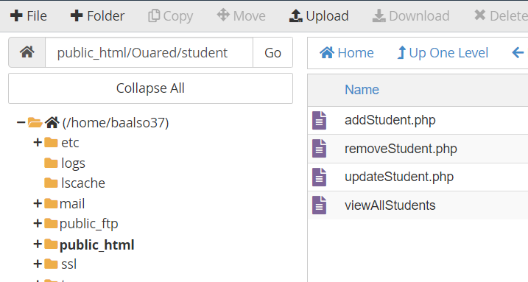
Common database functions in functions.php
Inside the studentAPI folder, create API files for CRUD operations:
addStudent.php: To add a new student record.
readAllStudents.php: To retrieve all student records.
selectStudent.php: To retrieve a specific student record.
removeStudent.php: To delete a student record.
updateStudent.php: To update a student record.

Slide 11
Implement the addStudent.php API:
Paste the code to insert a new student record into the student table.
<?php
include "../connect.php";
$first_name = filterRequest("first_name");
$last_name = filterRequest("last_name");
$date_of_birth = filterRequest("date_of_birth");
$email = filterRequest("email");
$phone_number = filterRequest("phone_number");
$data = array(
"first_name" => $first_name,
"last_name" => $last_name,
"date_of_birth" => $date_of_birth,
"email" => $email,
"phone_number" => $phone_number
);
// Assuming your table name is 'student', you can replace it with your actual table name.
insertData("student", $data, $json = false);
?>

Slide 12

Testing the API:
Use Postman to test the addStudent.php API.

Slide 13
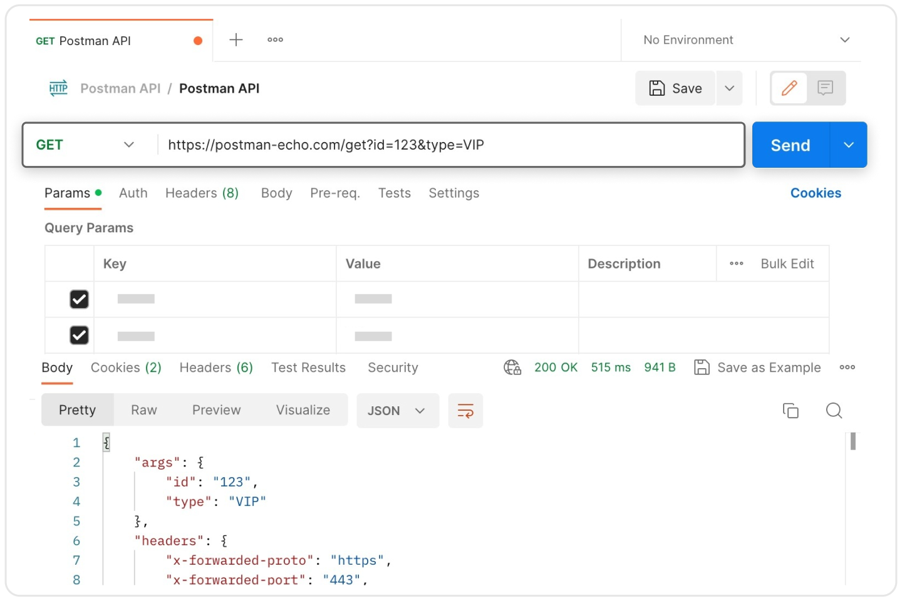
Testing the API:
Set the API URL as follows:
https://localhost/Ouared/student/addStudent.php

Slide 14
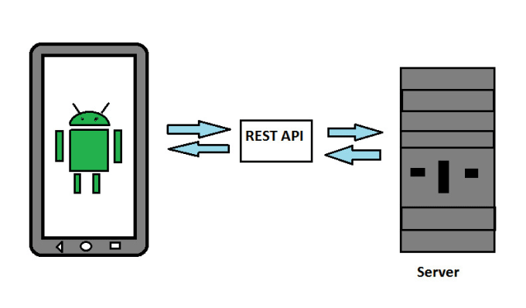
Testing the API:

Slide 15
General Steps (Valid for All Languages)
Step 1: Identify the API Endpoints
  https://localhost/Ouared/student/addStudent.php
Step 2: Prepare the HTTP Request
Step 3: Send the Request Using an HTTP Client
Step 4: Handle the Response

